Slide 1
Hands-On with DataSpaces on TACC Stampede
Instructors: Melissa Romanus,
Tong Jin, Prof. Manish Parashar
Rutgers Discovery Informatics Institute (RDI2)
July 2015

Slide 2
DataSpaces+Stampede Login Information
Open your favorite SSH Client or Terminal.
Log in to Stampede using the training account username and password provided to you:
ssh username@stampede.tacc.utexas.edu
Raise your hand if you are having any issues and an instructor will be happy to assist you.
Additionally, if your training acct is train##, where ## is greater than 65, please raise your hand.

Slide 3
Explore the $HOME Directory
We will be using DataSpaces version 1.5.0 for this tutorial. The current release, as of June 2015, is DataSpaces 1.6.0. The API is the same.
The tarball for 1.5.0 is included in your directory and DataSpaces 1.6.0 is available on our website: http://personal.cac.rutgers.edu/TASSL/projects/data/download.html
The expanded tarball and source code for DS is in $HOME/examples/dataspaces-1.5.0 if you are interested (it is not necessary to view the source code for this tutorial)

Slide 4
The Examples Directory
We have already loaded the examples for this tutorial onto the Virtual Machine in your home directory.
The exact location is $HOME/examples
Go into this directory.
$ cd examples
List the directory contents to verify that you have the examples for today’s tutorial.
$ ls
ex1_putget ex3_minmax ex5_matrix_mult
ex2_boundingBox ex4_2d_array mandelbrot
Notes:
Shorten URL, make off DS.org

Slide 5
A Programmer’s Overview of DataSpaces
Server/Client Terminology
Data Management
Put/Get
The Data Domain
Bounding Boxes
The DataSpaces API

Slide 6
Server / Client Terminology
In DataSpaces, the server consists of multiple server instances that run independently of user applications, on a set of nodes in the staging area
The server component provides the communication interfaces for interactions with the client components and other server component instances, such as, the metadata distribution, query routing, or application registration.
It also allocates the memory buffers to provide the storage required for the data inserted into the space
The client component is integrated with the user application and provides the interfaces for interacting with DataSpaces
It prepares and submits data queries received from the application to the space
Communications are non-blocking and re-entrant
Server component can process multiple queries and control messages
Client component can continue application flow and even call multiple writes to the space if initial write is still executing

Slide 7
Application Domain vs. DataSpaces Domain
The distribution of data differs between the application and DataSpaces
A continuous region in the application domain is split by DataSpaces into smaller sub-regions and continuous pieces of data associated with these sub-regions are located and stored at different nodes in the space
When a DataSpaces client requests such a region, it first connects to its corresponding node in the space, gathers the metadata and the location for all the pieces, and then requests the data from each individual node that has the sub-region

Slide 8
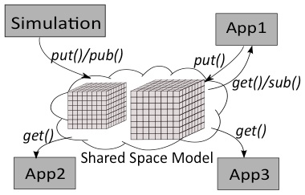
Data Management: Put and Get
Simulation
App1
App2
App3
Applications put and get data into/out of the space. A single application can both put and get data (as in App1).
Put: queries the space to insert data specified by a geometric descriptor
Get: queries the space to retrieve data specified by a geometric descriptor

Slide 9
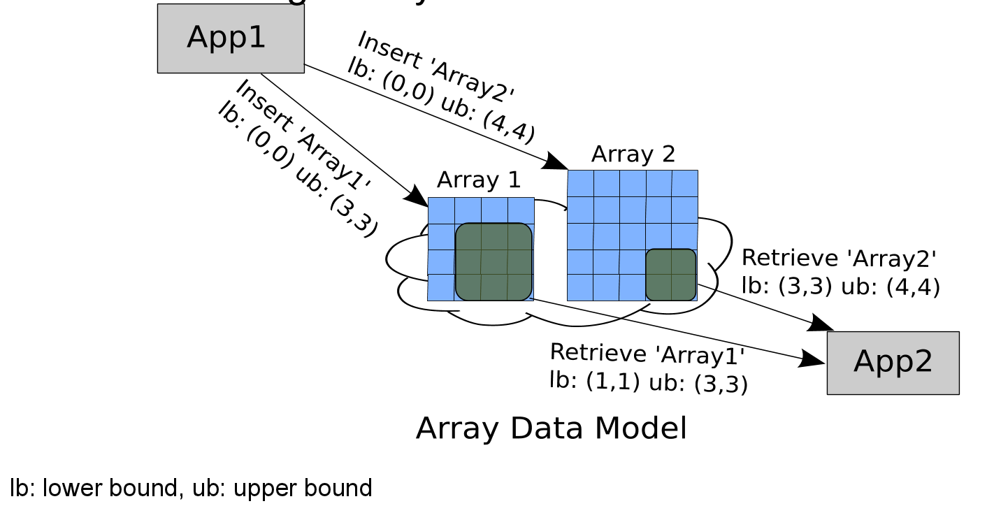
Bounding Boxes
Important Note: Ordering of dimension (fast->slow) is 0, 1, ..., n-1. Thus, for a C row-major array, the dimensions need to be reordered to construct the bounding box
For example, the bounding box for C array a[2][4] is lb: {0,0} ub: {3,1}

Slide 10
Staging Area Consistency: An Introduction to DataSpaces Locking
In order to maintain consistency when multiple clients are reading and writing from the staging area, DataSpaces implements read-locks and write-locks for the shared space
Lock: Obtain exclusive rights to access the space and ensure data coherency
Unlock: Release the exclusive access rights
Applications should acquire a lock before reading (get) or writing (put) data to/from DataSpaces
A lock may be obtained by all processes from one application or a subset of processes

Slide 11
Read-Lock / Write-Lock
Write-Lock: Processes that obtain the write-lock are permitted to add new data or change existing data in the space
A write-lock on the space will cause other processes to wait before they can read or write from it
Read-Lock: Processes that obtain the read-lock are permitted to read data from DataSpaces
A read-lock ensures that no data will be updated during the read
A Note on Concurrency: Multiple applications/processes can obtain a read-lock at one time (up to a user-specified MAX READERS variable, which we will discuss later). This is more commonly referred to as a Shared-Exclusive Lock.
For example, if MAX READERS is set to 10, up to 10 processes could obtain the read-lock in order to read data out of the space
Setting the MAX READERS variable is meant to prevent write-starvation
Notes:
Technically this is a lie

Slide 12
Locking Schemes in DataSpaces
There are two locking schemes in DataSpaces, both of which have read-locks and write-locks
Both are read-preferring shared-exclusive locks, as previously discussed
Traditional Shared-Exclusive Lock (generic): FCFS
User is responsible for synchronization
Publisher (writer) is allowed to progress at its own pace
Consumer (reader) can obtain a read-lock and try to read data before valid data has been put in the space
Strict Order-Enforced Shared-Exclusive Lock:
This is a special type of lock that enforces a Write-Read-Write-Read access scheme to the data space
No user-based synchronization is required in the application
Consumer will block until Producer puts (produces) data
Producer will block until Consumer gets (consumes) data

Slide 13
Locking: Today’s Tutorial
In today’s tutorial, we will use the Strict Order-Enforced Shared-Exclusive Lock
Why? It simplifies the examples by eliminating the need for user-based synchronization of data.
In your applications, you will most likely NEVER use this lock. We will show you how to change the lock type during this tutorial.

Slide 14
Code Development with the DataSpaces API
Introduction
Initialization and Finalization
Put and Get Data
Lock Mechanisms
Notes:
Before we look at the ode,

Slide 15
Introduction
We will discuss the various functions available to the user as part of the DataSpaces API
Internally, DataSpaces uses the Message Passing Interface (MPI) for communication (applications don’t have to use MPI)
DataSpaces is designed to work with C or Fortran code
Today, we will be working in C
At the top of your C file, use
#include “dataspaces.h”
Note: You don’t have to memorize the code in this section. We will be going into more detail when we get to the examples.

Slide 16
DataSpaces API: Initialization and Finalization
dspaces_init: Initializes the framework and registers a new application with the DataSpaces framework
Function Call: dspaces_init(int num_peers, int appid, void *comm, const char *parameters)
num_peers: Number of connecting clients to the DS server
appid: Unique identifier (integer) for the individual application
comm: Pointer to the MPI Communicator (MPI_COMM_WORLD)
parameters: Placeholder for future arguments, currently NULL
dspaces_finalize: Releases resources and unregisters an application from the DataSpaces framework
Function call: dspaces_finalize()

Slide 17
DataSpaces API: Put and Get Data
Recall that put is for inserting data into the space and get is for retrieving data from the space. Both functions take the same argument list.
dspaces_put(const char *var_name,
unsigned int ver, int size, int ndim, uint64_t *lb, uint64_t *ub, void *data)
dspaces_get(const char *var_name,
unsigned int ver, int size, int ndim, uint64_t *lb, uint64_t *ub, void *data)
var_name: The name of the variable that will be put into the space
ver: The version number for the data (useful when multiple timesteps)
size: The size (in bytes) of each element
ndim: Number of dimensions of the local bounding box
lb: Lower bound of local bounding box
ub: Upper bound of local bounding box
data: Pointer to the data buffer
For put, this is the data you will put into the space
For get, this is a data structure that you will place the data retrieved from the space
Notes:
----- Meeting Notes (1/12/15 12:39) -----
Repeat bounding boxes stuff. Pictures that say what do we mean by each of these parameters

Slide 18
DataSpaces API: Lock Mechanisms
Recall that the lock mechanisms allow applications or a subset of processes to obtain exclusive rights to the space
dspaces_lock_on_write(const char *lock_name, void *comm)
dspaces_unlock_on_write(const char *lock_name, void *comm)
dspaces_lock_on_read(const char *lock_name, void *comm)
dspaces_unlock_on_read(const char *lock_name, void *comm)
lock_name: Unique name for your lock
comm: Pointer to the MPI Communicator (MPI_COMM_WORLD)
MPI communicator is optional

Slide 19
Code Deployment: Configuring DataSpaces
dataspaces.conf
Configuration file that describes the global data domain
## Config file for DataSpaces
ndim = 3
dims = 10,10,10
#
max_versions = 10
max_readers = 1
# Lock type: 1 - traditional, 2 - strict
lock_type = 2
dataspaces_server
Server binary compiled for the architecture that you will be running on
./dataspaces_server -s 1 -c 2
Specifies a server running with 1 process and 2 client processes
mpirun –np 4 ./dataspaces_server -s 4 -c 1000
Specifies 4 DataSpace servers with 1000 connecting clients

Slide 20
Examples
Example 1: Simple Put/Get
Example 2: Adjusting the Bounding Box
Example 3: Finding the Minimum, Maximum, and Average of the Data in the Data Domain
MPI
Example 4: Working with 2D Arrays in DataSpaces
Example 5: Matrix Multiplication
Example 6: The Mandelbrot Set
Notes:
Examples and names

Slide 21
Example 1: Put / Get
In this first example, we will write a 1-dimensional array with 3 values to the space in the box bounded by the origin (0,0,0)
put()
int* data[3]
version: timestep
get()
int* data[3]
version: timestep
We will “put” data for 10 different timesteps into the DataSpace using one application and then “get” it out using a different application

Slide 22
Example 1: Compile the Example
Go into the examples directory.
$ cd examples/ex1_putget
Compile the example
Note that the Makefile specifies three variables needed to compile with DataSpaces (DATASPACES_DIR, DATASPACES_INC, DATASPACES_LIB)
The paths to these directories are already set for you in these examples.
$ make
A Note on Compiling: Although this example does not use MPI, we will still compile with the mpicc compiler, because the DataSpaces libraries and directories that we are linking in do use MPI.
MPI is not required within the examples themselves, but it is required to compile DataSpaces itself.

Slide 23
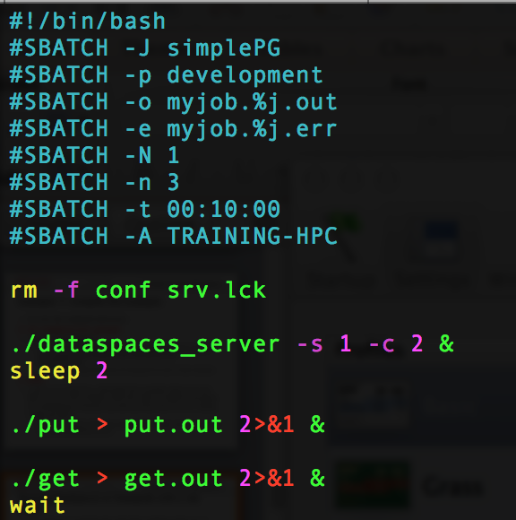
Running DataSpaces on Stampede with a Job Script
Let’s look at an example job script that combines what we’ve learned today for submitting to a SLURM cluster using DataSpaces.
NOTE: For this tutorial, we will modify job.sh.
Add the line:
#SBATCH --reservation=DataSpaces
Change the line:
#SBATCH –p development
to
#SBATCH –p normal
We will do this in every example directory.

Slide 24
Do This Quickly…
Make sure you are at the root of the examples directory.
login3.stampede(3)$ pwd
/home1/0005/train51/examples
find . –name "job.sh" -exec sed –I'' -e 's/development/normal/g' {} +
find . -name "job.sh" -exec sed -i'' -e '/#SBATCH -A TRAINING-HPC/a #SBATCH --reservation=DataSpaces' {} +

Slide 25
Example 1: Running the Example
Open ex1_putget/job.sh to see how we will be running DataSpaces.
For this example, we will use the file put.c and get.c, which only have one process each. Therefore, there are 2 connecting clients.
./dataspaces-server –s 1 –c 2 &
./put &
./get &
Submit our job:
$ sbatch job.sh
For this tutorial, DataSpaces will wait for all connecting clients to join.

Slide 26
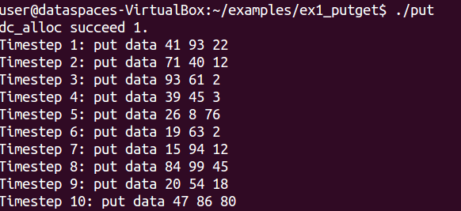
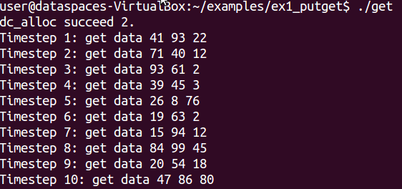
Example 1: Examining the Output
Once your job runs, open “put.out”, you should see the following output:
Open “get.out” Terminal, you should see the following output:
Verify that this data is the same for both.
Note: Your values will differ from the example because they are initialized using the rand() function.

Slide 27
Example 1: Server Output
Also, you can open the job script (e.g, myjob.JOB_ID.out, where the DataSpaces server was running.
IMPORTANT: When you run DataSpaces, it creates two files in your run directory called srv.lck and conf. If the server exits normally, srv.lck is removed but conf is not. To rerun the example, you will need to manually remove these files.
$ rm conf
$ rm srv.lck # if it exists
However, for this tutorial, our job.sh script removes these files from the current directory when it first runs, so we need not delete it.
from the examples/ex1_putget directory
Notes:
You should see the following output:
Why do we save conf? In case people need to know where the job ran (nodes-wise).
----- Meeting Notes (1/12/15 12:39) -----
change the yellow. why do we not remove conf as part of the finalize?

Slide 28
Example 1: Code Walkthrough
Now that we see how DataSpaces works, let’s open the put.c and get.c code.
You can use your favorite text editor to open the files. We will use vim (because of its universality). If you prefer a more graphical text editor, replace vim with gedit in the following command.
$ vim put.c
Notice the #include “dataspaces.h” on Line 8
1 /* put.c : Example 1: DataSpaces put tutorial
2 * This example will show you the simplest way
3 * to put a 1D array of 3 elements into the space
4 * */
5 #include <stdio.h>
6 #include <stdlib.h>
7 #include <stdint.h>
8 #include "dataspaces.h"

Slide 29
Example 1: Code Walkthrough, put.c
Line 20: dspaces_init(1, 1, &gcomm, NULL);
Tells DataSpaces we will have 1 process connecting, the application ID is arbitrarily chosen as 1, we pass the MPI communicator, and NULL for the parameters list
Line 25: while loop to generate data for the different timesteps
Line 31: dspaces_lock_on_write("my_test_lock", &gcomm);
Every timestep, we will be writing 3 new values, so obtain a write-lock on the DataSpace. This is a custom producer/consumer lock, which we have arbitrarily named “my_test_lock”
Line 79: dspaces_finalize();

Slide 30
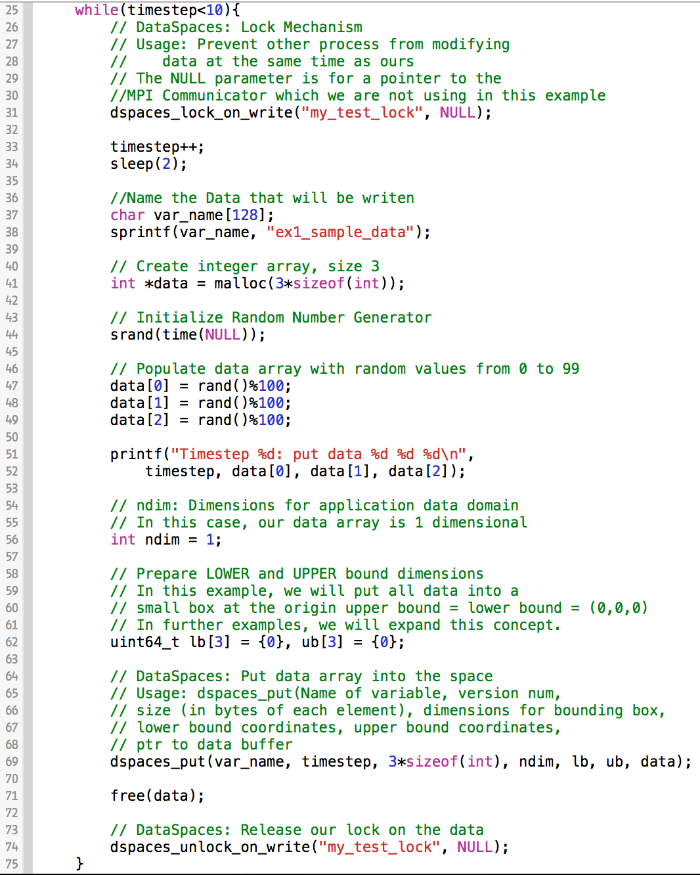
Obtain the write-lock for this time step
Name the data to be written
Create our data buffer and populate with values
Define our local bounding box as 0,0,0 for upper and lower bounds
Put the data into the space
Release the write-lock for this time step
put.c
Notes:
----- Meeting Notes (1/12/15 12:39) -----
Animation, magnify the code at certain points.

Slide 31
Example 1: Code Walkthrough, get.c
The get file is very similar to the put file, except that we create the buffer and do not populate it
The buffer will be populated as a result of dspaces_get())
Open the get file
$ vim get.c
Notice for the initialization (dspaces_init(),Line 16), we use an application ID of 2 (because put.c is application ID 1)
dspaces_init(1, 2, &gcomm, NULL);

Slide 32
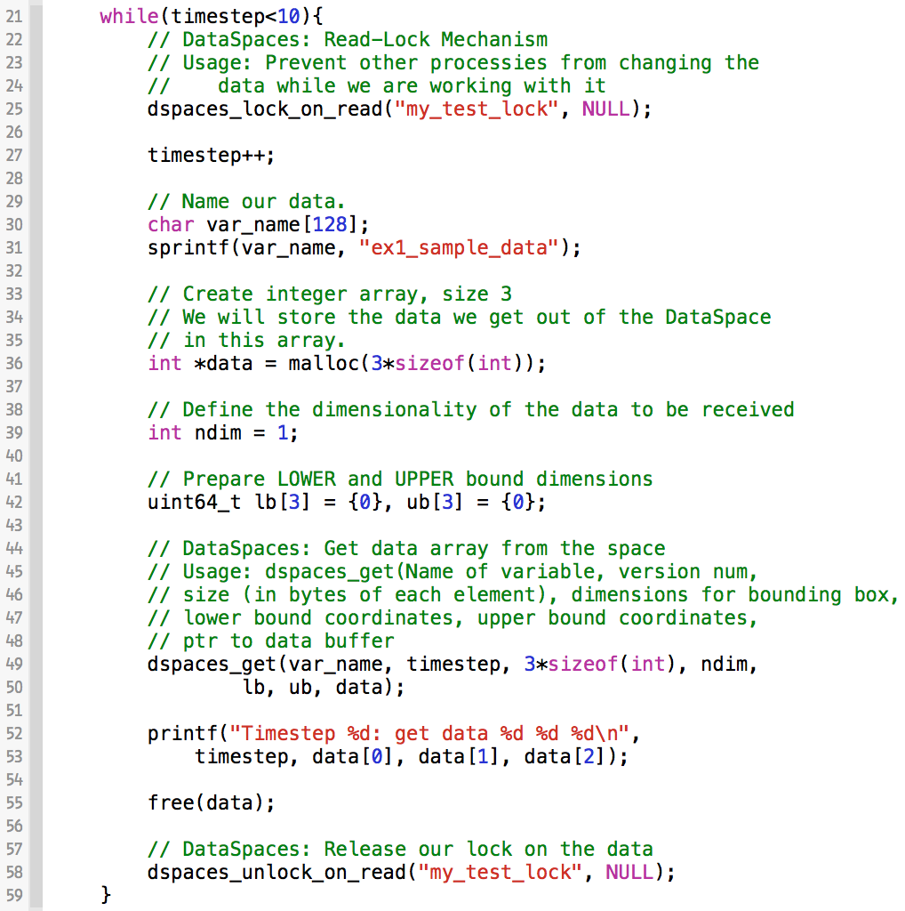
Obtain the read-lock for this time step
Variable name must be the same as the one we put into the space
Data buffer is a placeholder for the data we will get
Get the data from the space and place in our int* data buffer
Release the read-lock for this time step
get.c

Slide 33
Example 2: Bounding Box
Now that we see how to put data into the space, we will put in a slightly larger array (50 values)
Instead of putting all 50 values at (0,0,0), we will place five integers in each box along the X-direction of the data domain.
For example, data[0] through data[4] will go to (0,0,0), data[25] through data[29] will be inserted at (5,0,0), and data[44] through data[49] will be inserted at (9,0,0)
We are able to achieve this using a single dspaces_put command
Let’s take a look at the code
$ cd ex2_boundingBox
$ vim ex2_put.c
0,0,0 vals 0-4 | 1,0,0 vals 5-9 | 2,0,0 vals 10-14 | 3,0,0 vals 15-19 | 4,0,0 vals 20-24 | 5,0,0 vals 25-30 | 6,0,0 vals 31-34 | 7,0,0 vals 35-39 | 8,0,0 vals 40-44 | 9,0,0 vals 45-49
Notes:
EDIT DATASPACES.CONF FOR EXAMPLE 2.

Slide 34
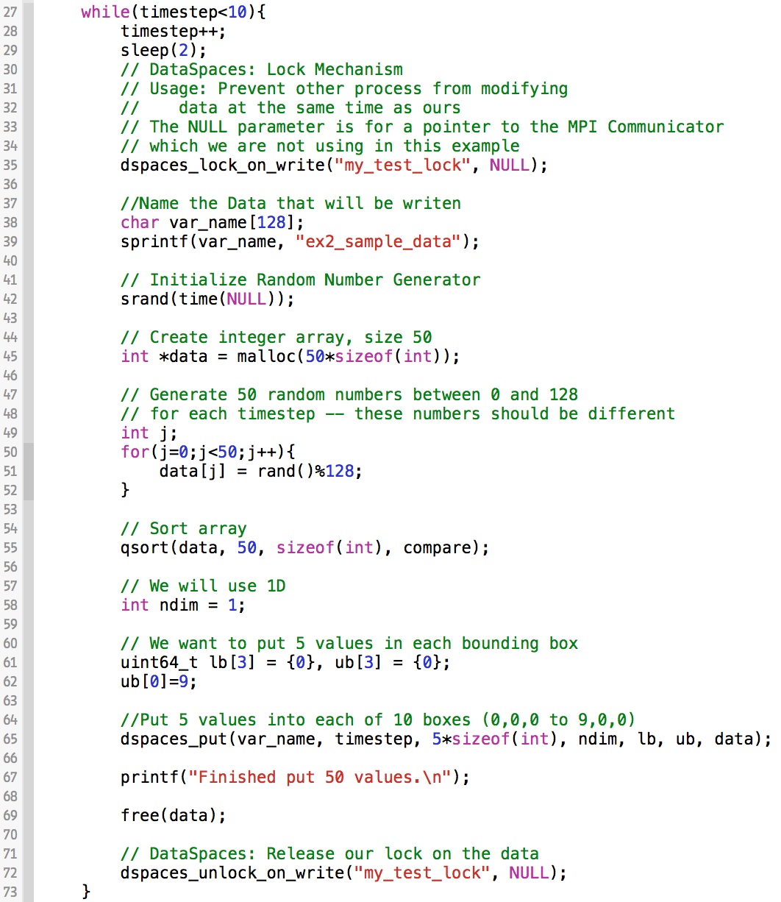
Example 2, Bounding Box, put.c
Create a size 50 integer array, populate with random values, and (optionally) sort
Define bounding box from lb: (0,0,0) to ub: (9,0,0)
In the put, we specify the size of each “box” as 5*sizeof(int). This means 5 integers can be stored at each location

Slide 35
Getting Data from a Sub-Region
0,0,0 vals 0-4 | 1,0,0 vals 5-9 | 2,0,0 vals 10-14 | 3,0,0 vals 15-19 | 4,0,0 vals 20-24 | 5,0,0 vals 25-30 | 6,0,0 vals 31-34 | 7,0,0 vals 35-39 | 8,0,0 vals 40-44 | 9,0,0 vals 45-49
Now, for the get routine, we will ask for the ten values defined in boxes 3,0,0 and 4,0,0 for each timestep
Why? Suppose a simulation event that we were waiting for occurs at only these timesteps. We might be interested in only these values to perform further calculation on.
Open the get file
$ vim get.c
Notes:
----- Meeting Notes (1/12/15 12:39) -----
improve the picture a bit.

Slide 36
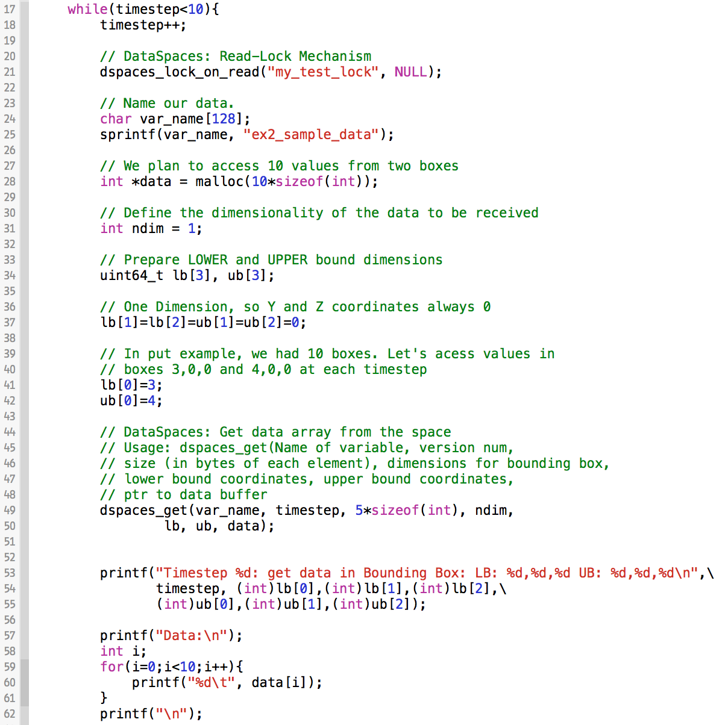
Example 2, Bounding Box, get.c
Create a data buffer large enough for 10 values, since we will access 2 boxes
Set the lower bound at 3,0,0 and the upper at 4,0,0
Note that the size itself is still 5*sizeof(int) because that is the size of the individual box
Print information for the user

Slide 37
Example 2: Compiling/Running the Example
In your current terminal, compile the example.
$ make
Submit your job to the queue
$ sbatch job.sh

Slide 38
Example 3: Min, Max, Average
This example will expose us to some new terminology. We will call the application that is “putting” data into the space the “writer” and the application that is “getting” data from the space the “reader.”
This is simply a naming convention. It is possible for an application to both read and write.
In this example, we will write a 1D array consisting of 128 values into the space for only 1 timestep
The values will vary in range from 0 to 64k
We will then have multiple reader processes reading chunks of the space to compute the min/max/average
What changes?
We no longer have just 2 clients connecting to the DataSpaces server.
$ cd examples/ex3_minmax

Slide 39
Example 3
1D Array, 128 integers
0 |  |  |  |  | … |  |  |  |  | 127
put()
get()
Rank 7:
Local min, max, avg
Rank 0:
Local min, max, avg
112 | … | 127
0 | … | 15
DataSpaces
Staging Area
get()
get()
Rank 6:
Local min, max, avg
Rank 1:
Local min, max, avg
get()
16 | … | 31
96 | … | 111
get()
get()
get()
get()
Rank 2:
Local min, max, avg
Rank 3:
Local min, max, avg
Rank 4:
Local min, max, avg
Rank 5:
Local min, max, avg
32 | … | 47
48 | … | 63
64 | … | 79
80 | … | 95
Compute Global Min, Max, Avg
Notes:
When extra time, animate

Slide 40
Example 3, Min Max Average Writer
The concepts explored in minmaxavg_writer.c have been thoroughly covered in Examples 1 and 2. We create the array, populate it with values, then store it into the space.
$ vim minmaxavg_writer.c
We will just call your attention to how the data is stored in the DataSpace. One integer in each box.
uint64_t lb[3] = {0}, ub[3] = {0};
ub[0] = ARRAY_SIZE-1;
// 1 integer in each box, fill boxes 0,0,0 to 127,0,0
dspaces_put(var_name, timestep, sizeof(int), ndim, lb, ub, data);

Slide 41
Example 3, Min Max Average Reader
Please open the reader file. We will use MPI to divide the work up to processes and then MPI_Reduce to get the global minimum, maximum, and average for the array.
$ vim minmaxavg_reader.c
First, notice that we have added #include “mpi.h” to the top of the file
Next, call your attention to the dspaces_init function. Now that we are using a number of processes specified on command line, we use nprocs as the number of peers.
dspaces_init(nprocs, 2, &gcomm, NULL);

Slide 42
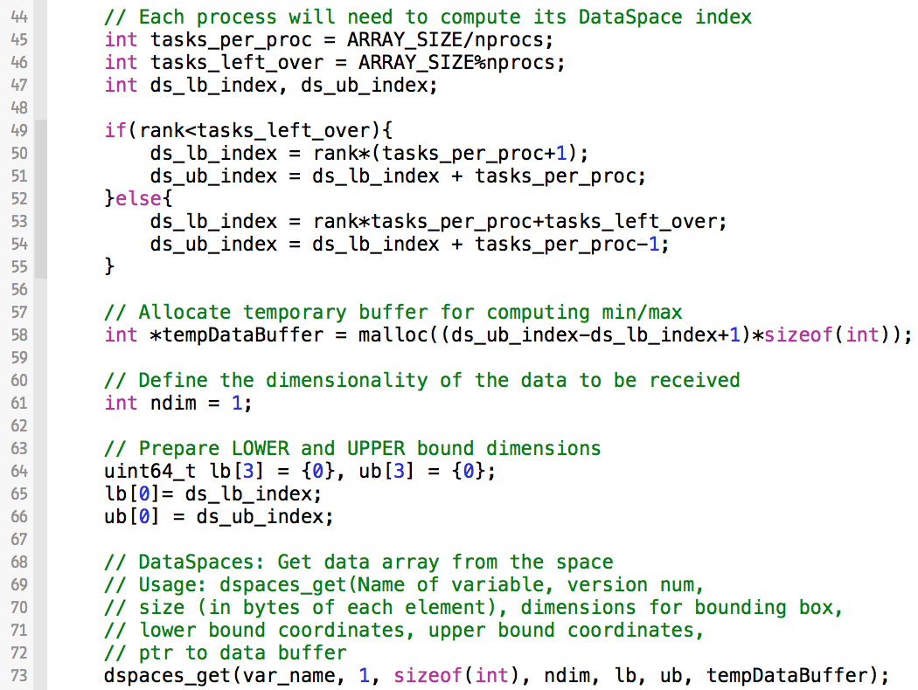
Example 3, Min Max Average Reader
Example 3, minmaxavg_reader.c
Need to evenly divide the work for each process based on the number of processes provided by the user
Use indices to allocate proper buffer space
Define the box that each process will select (X1, 0, 0) to (X2, 0, 0)
Finally, get the data from the space and store it in the buffer. Note: sizeof(int) because there’s one integer in each box

Slide 43
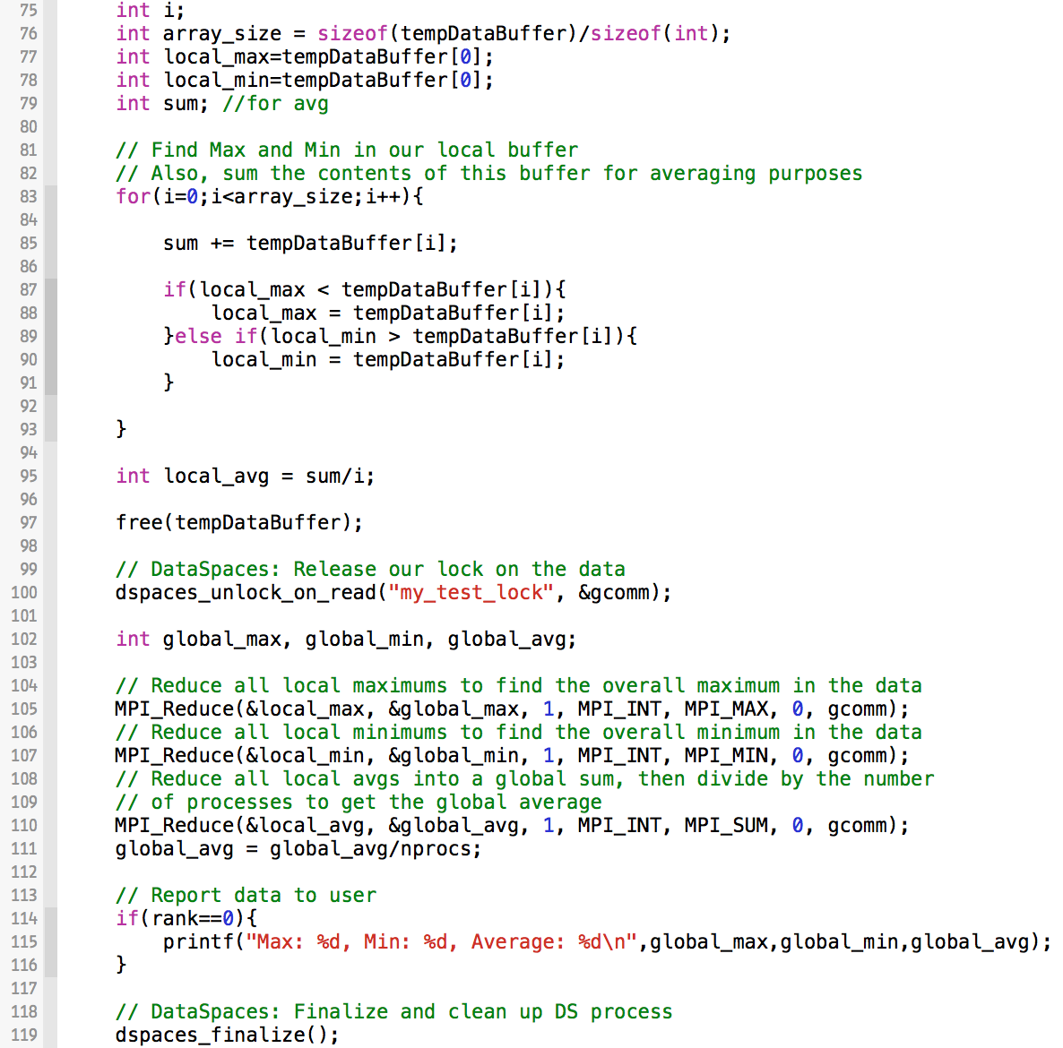
Example 3, minmaxavg_reader.c
Compute local min, max, avg based on slices
Reduce the local values into global values
Print result to user from rank 0
Clean up DataSpaces

Slide 44
Example 3, DataSpaces Configuration
## Config file for DataSpaces
# could also use 2 dims
ndim = 3
dims = 128,128,128
#
max_versions = 1
max_readers = 1
# Lock type: 1 - generic, 2 - custom
lock_type = 2

Slide 45
Example 3: Compiling/Running
In your current terminal, compile the example.
$ make
This is the first example where we are using MPI, so let’s take a look at job.sh
$ vim job.sh
Note: ibrun is a TACC specific construct. It semi-replaces mpirun.
For example:
$ mpirun –np 8 ./minmaxavg_reader
is $ibrun -o 1 -n 8 ./minmaxavg_reader
Submit your job and examine the output.
$ sbatch job.sh

Slide 46
Example 4: Working with a 2D Array
The past three examples have all shown how to work with 1D arrays in DataSpaces, but this example will show how to put a static 2D and a dynamic 2D array into the space.
$ cd ex4_2d_array
$ ls
dynamic2d static2d
Let’s start with the static example. In a static array, the memory allocated is contiguous, which means we can easily store it in the space.
$ cd static2d
$ vim put_2d.c

Slide 47
Example 4: Static 2D
put()
DataSpaces
Staging Area
get()

Slide 48
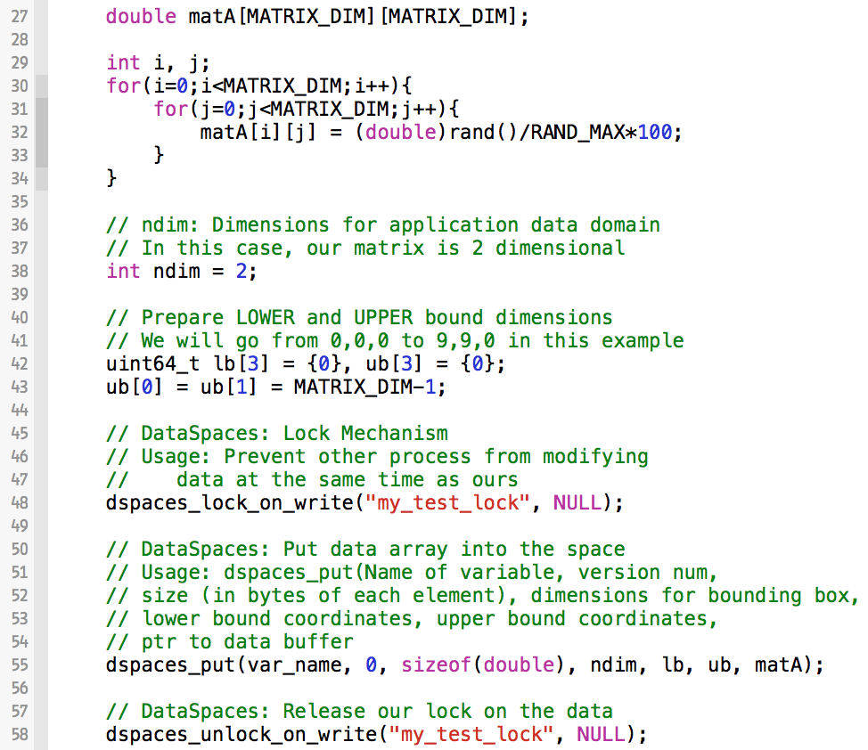
Example 4, static2d/put_2d.c
Create static array of doubles and populate with random doubles from 0 to 100
Define the data as 2D and bounds now change on the X and Y values
(0,0,0) to (X, Y, 0)
Store the array into the space

Slide 49
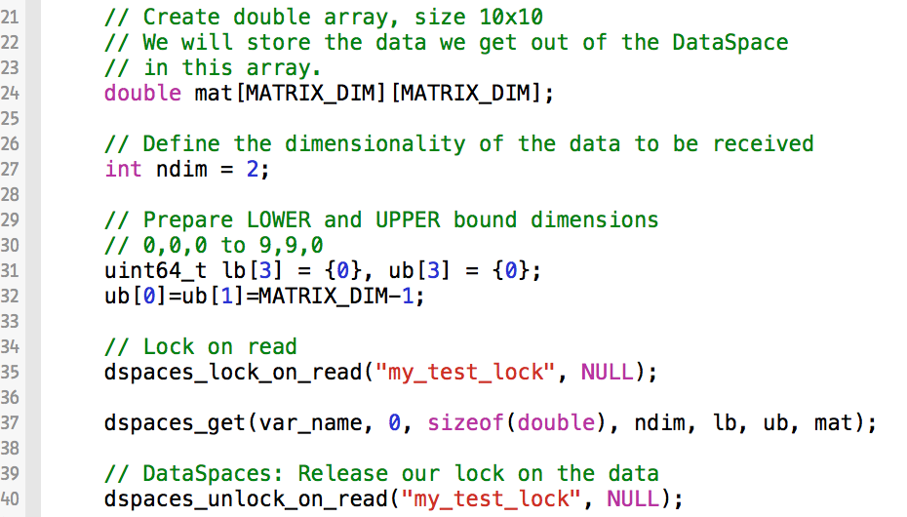
Example 4: Working with a 2D Array
For simplicity in this example, we only use 1 timestep and 1 reader, 1 writer.
$ vim get_2d.c
Note that the get_2d code is almost identical, except that we are getting the data out instead of putting it in

Slide 50
Example 4: Compiling/Running Static2d
In your current terminal, compile the example.
$ make
Submit the job
$ sbatch job.sh
Here, we just verify that the array we put in is what we get out.

Slide 51
Example 4: Working with a 2D Array
In a dynamic array, the memory is allocated on the heap at runtime. The way we declare the array in this example does not guarantee that the memory is contiguous.
Why show this example? Existing programs use a variety of formats and data structures, so we want to show how to integrate DataSpaces in a variety of situations.
$ cd ex4_2d_array/dynamic2d
$ vim put_2d.c

Slide 52
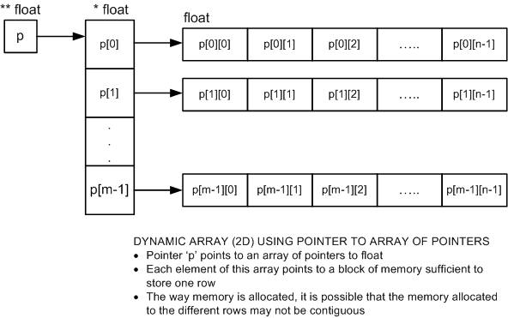
Dynamic Array Review
** int
* int
int
integers
Annigeri, Satish. "Dynamic Two-dimensioned Arrays in C." Web log post. Programming, Numerical Computation and FOSS. Blogger, 16 Nov. 2011. Web. 20 Jan. 2015. <http://www.annigeri.in/2011/11/dynamic-two-dimensioned-arrays-in-c.html>.

Slide 53
Example 4: Dynamic 2D
DataSpaces
Staging Area
get()
put()
get()
…
…
put()
get()

Slide 54
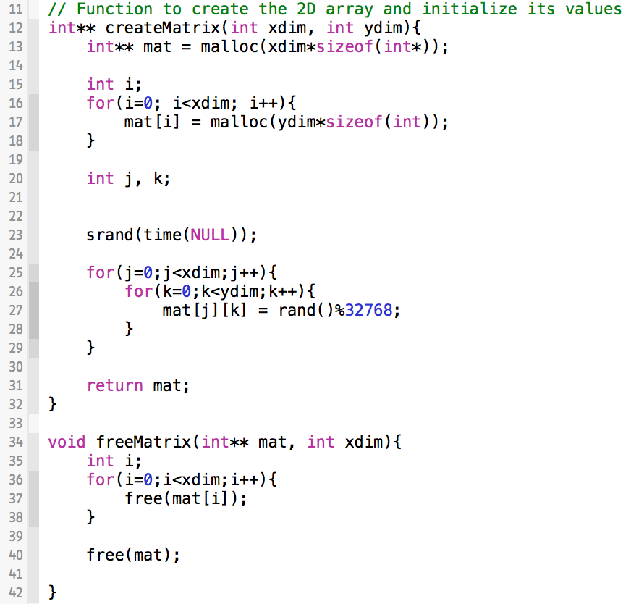
Example 4, dynamic2d/put_2d.c
Function to create dynamic integer array using pointers to pointers
Initialize the array with random numbers from 0 to 32k
Function to free the memory allocated after data is put into the space

Slide 55
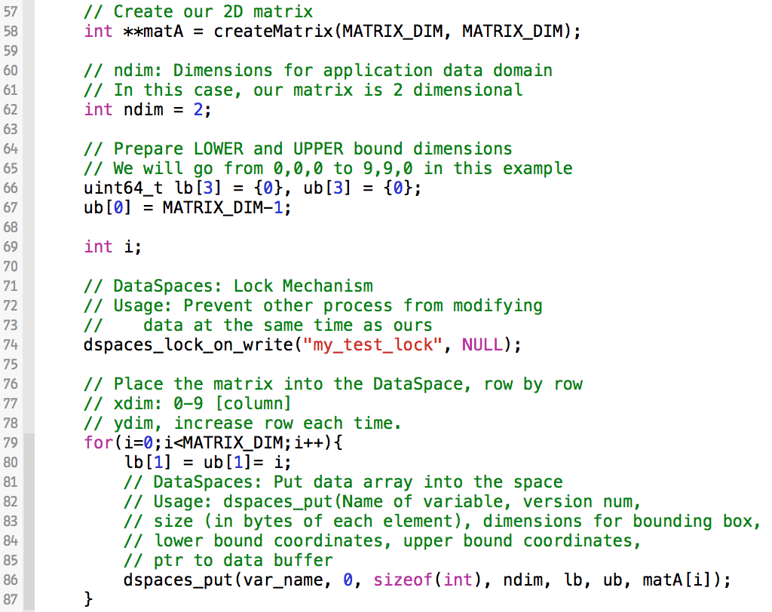
Example 4, dynamic2d/put_2d.c
Because of the way the memory is allocated, the rows are contiguous spaces. We can iterate over the rows of our data structure and place each one into the space with a dspaces_put call.
Notes:
----- Meeting Notes (1/12/15 12:39) -----
fix text .

Slide 56
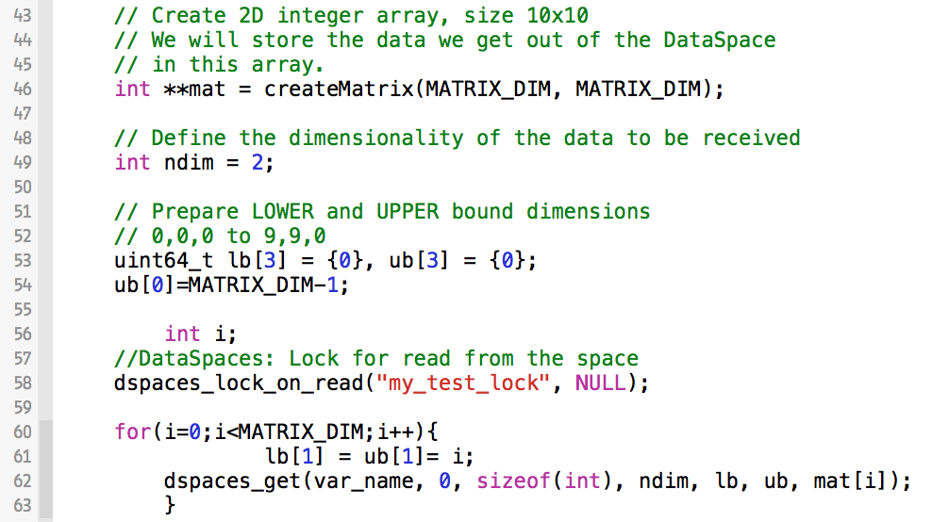
Example 4, dynamic2d/get_2d.c
Next, open the get function.
$ vim get_2d.c
In the get function, we do exactly the same thing to get the original data structure back.
We call get for each row of the matrix and store it into a 2d dynamic array. After the gets complete, we can access
mat[matrix_dim][matrix_dim]

Slide 57
Example 4: Compiling/Running dynamic2d
In your current terminal, compile the example.
$ make
Submit the job
$ sbatch job.sh
Here, we just verify that the array we put in is what we get out.

Slide 58
Example 5, Matrix Multiplication
In this example, we will expand upon Example 4, Dynamic 2D, by placing 2 different matrices into the space
These matrices will occupy the same space in the data domain, with different variable names
The reader application (get) will perform matrix multiplication and return the result to the user. We will run the reader application with multiple processes.
The matrix multiplication is performed via a traditional algorithm, wherein all processes retrieve a copy of Matrix B and then workers obtain rows of Matrix A to multiply against all of B to form the resultant Matrix C
$ cd ex5_matrix_mult
$ vim matrix_write.c

Slide 59
Example 5, Put the Matrices into the Space
Matrix A
DS Staging Area
put()
put()
put()
put()
put()
put()
Matrix B
put()
put()
put()
put()

Slide 60
Example 5, Get the Data from the Space
Each Process…
DS Staging Area
Row(s) of Matrix A
get()
get()
# of Rows =
# of processes / matrix dimension
…
get()
Matrix B
get()

Slide 61
Example 5, Multiplication (per process)
Matrix B
Matrix C
x
Row(s) of Matrix A
=

Slide 62
Example 5, Put Matrices into the Space
Values for matrix are digits between 0 and 9
Code is designed to work only with square matrices
We start with a matrix size of 5x5.
While DataSpaces is meant for much larger datasets, it is easier to verify visually that the code is working correctly with this smaller example
After the tutorial, you may wish to adjust the matrix sizes to be much larger and add some performance/timing measurements
Note that the put.c code is the same as Example 4, Dynamic 2D
The only difference is that we put two matrices into the space instead of one
Note that the variable name changes for each one to be unique to that matrix
$ vim matrix_read_mult.c
Notes:
NOTE: Clean this code, while rank != nprocs, then set variable name with

Slide 63
Example 5, Code Walkthrough for get_2d.c
In the get_2d.c code, we will utilize both dynamic and static arrays.
At the top of the code (Line 10), we define the resultant matrix as a contiguous block of memory (resultMat)
Let’s step through this code to analyze what’s going on
$ vim get_2d.c
// Define resultant matrix container
int resultMat[MATRIX_DIM][MATRIX_DIM];
Notes:
NOTE: Line 10 may change.

Slide 64
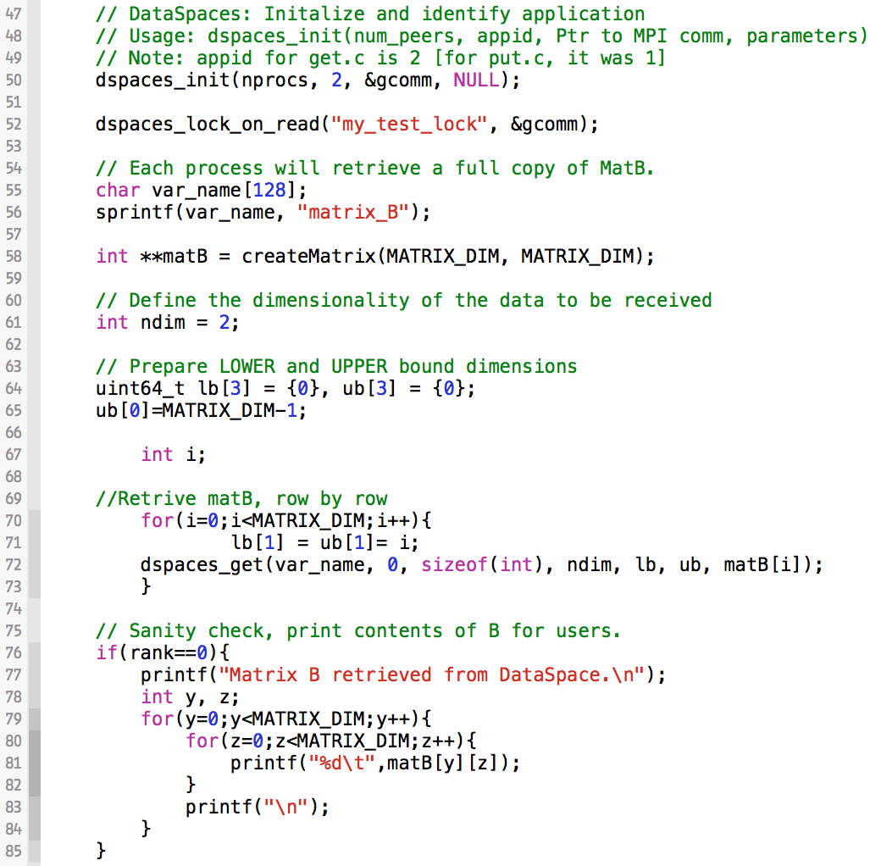
Example 5, get_2d.c, 1 of 4
Initialize DataSpaces and Obtain Read-Lock
First, every process retrieves a local copy of matrix B from the space
Print Matrix B to verify that its contents are the same as what was put in to the space

Slide 65
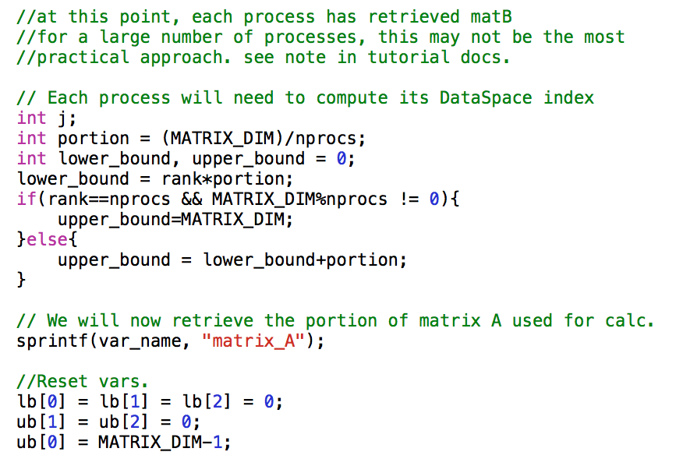
A Quick Note: For very large matrices, it may not be practical for all of the connecting clients to access the space in order to read Matrix B at the same time. In this case, it is recommended to have process 0 read Matrix B and use the traditional MPI_Send to farm it out to the worker processes
Example 5, get_2d.c, 2 of 4
We need to compute how many rows of A each process will get and perform the multiplication with. Lower bound is the start row of A, upper bound is the finish row of A for this process
Since we are retrieving an entire row, the bound is 0,0,0 to XMAX, 0, 0

Slide 66
A Quick Note: For very large matrices, it may not be practical for all of the connecting clients to access the space in order to read Matrix B at the same time. In this case, it is recommended to have process 0 read Matrix B and use the traditional MPI_Send to farm it out to the worker processes

Slide 67
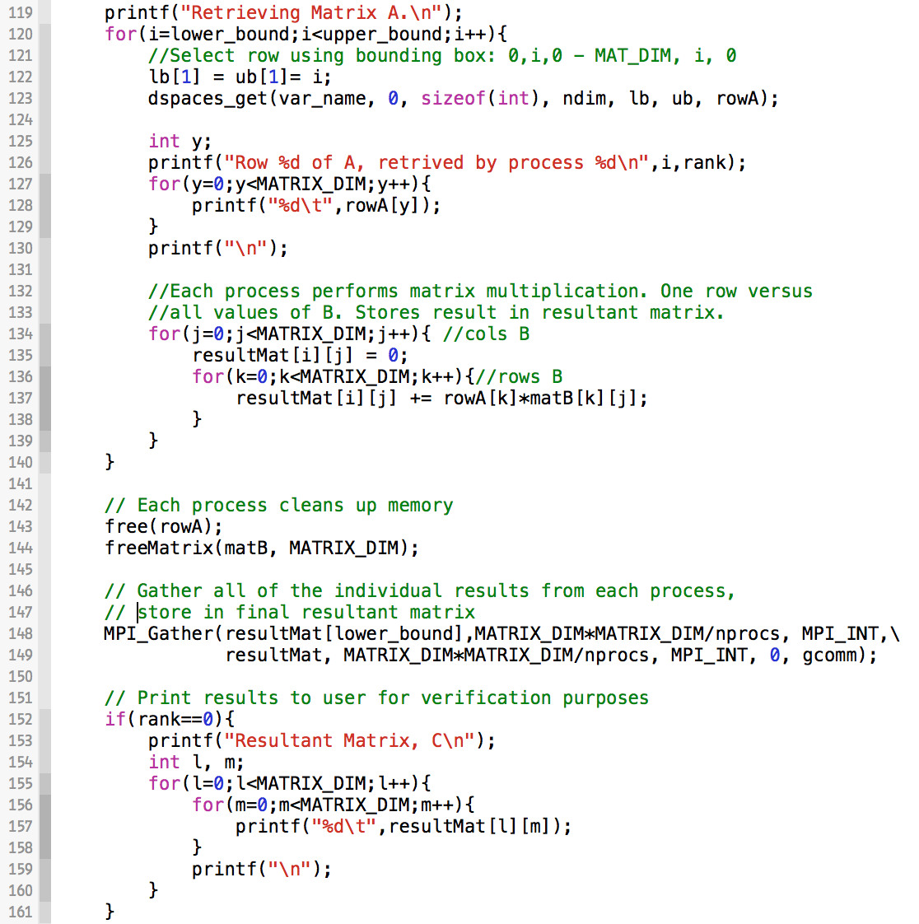
Example 5, get_2d.c, 3 of 4
Retrieve a row of A
Print this row and the process rank to the user for verification purposes
For this row, perform matrix calculation against all of matrix B. This forms a row of resultant Matrix C
Clean up the memory
Gather all of the local rows of C into the final matrix C
Print the resultant Matrix C to the user

Slide 68
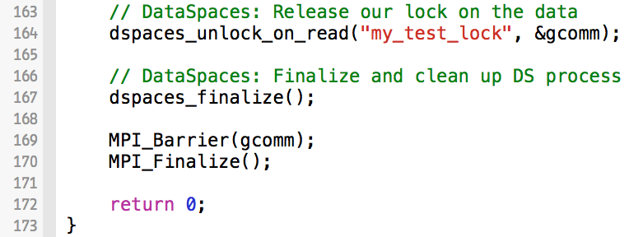
Example 5, get_2d.c, 4 of 4
Release the read-lock
Call DataSpaces Finalize
Finalize the MPI communication
Return exit status 0, success ☺
In your current terminal, compile the example.
$ make

Slide 69
Example 5: Running the Matrix Multiplication
Compile the example using make.
Examine job.sh. Now we will use MPI for both the reader and writer.
./dataspaces-server –s 1 –c 7
# mpirun –np 2 ./matrix_write
ibrun -o 1 -n 2 ./matrix_write
# mpirun –np 5 ./matrix_read_mult
ibrun -o 3 -n 5 ./matrix_read_mult

Slide 70
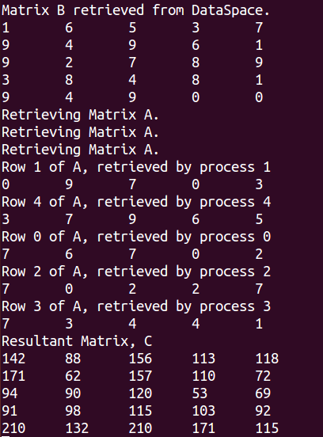
Example 5: Examining the Output
$ cat write.out
$ cat result.out
Remember: Your actual values will vary because they utilize the rand() function

Slide 71
If your linear algebra is rusty…
1
1 http://www.wolframalpha.com/

Slide 72
Example 6: Mandelbrot Fractals
In this example, we will compute Mandelbrot fractals, which are infinitely recursive.
We will write 50 different versions to the staging area and then extract these values in order to construct a series of fractal images (such as the one pictured below).
Ensure that you are in the example 6, mandelbrot, directory
$ cd mandelbrot
$ make
¹
¹http://en.wikipedia.org/wiki/Mandelbrot_set

Slide 73
Example 6: Bag of Tasks
In this example, we show how you can insert tasks into the space in a master code and use N number of works to retrieve tasks and operate on the data.
This MPI version of mandelbrot works by varying the scale from 2 down to the scale specified on command line. Each of the images represents a different scale, but the x, y, height, width, and maximum iterations remains the same.
This example may not be very interesting in terms of initial data, because many of the tasks need the exact same data. The point is to show a different use case for DataSpaces.

Slide 74
Inserting a Struct
Instead of doubles or ints, we will now create our own struct and insert the struct into the space (composed of doubles and ints)
Recent Q: Can the types of variables switch from index to index in the DS?
Example: Same variable name. Insert int into one index, double into next index, back to int, back to double.
A: In general, you cannot mix and match. However, you could put the int and double into the same index, using sizeof(int)and sizeof(double). Then the access becomes uniform. Alternatively, you could make a struct to support this, as we do in this example.

Slide 75
Example 6, Put Data for 50 Tasks into the Space
0
put()
1
put()
512x512
DataSpaces
Staging Area
2
put()
512x512
512x512
put()
…
put()
47
48
put()
512x512
49
512x512
512x512

Slide 76
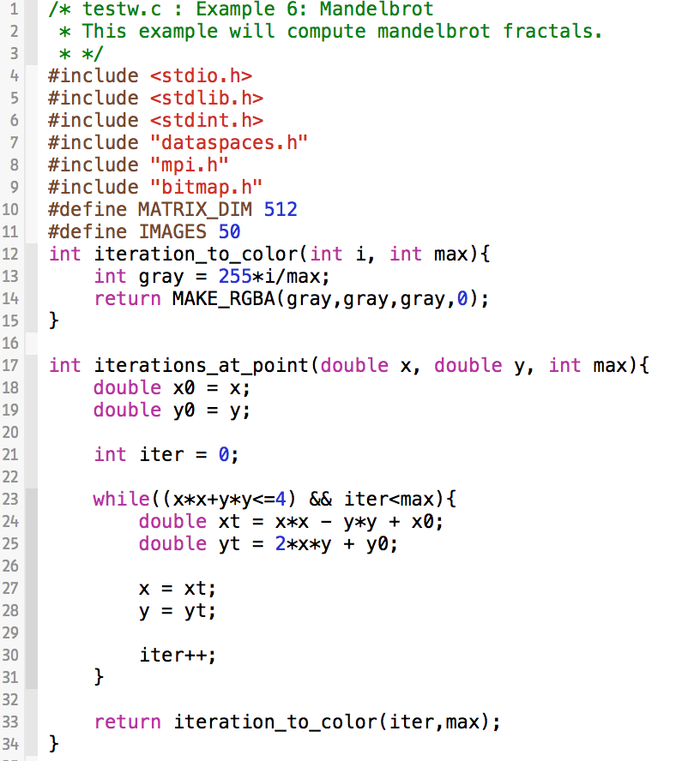
Example 6, testw.c, 1 of 4
Print this row and the process rank to the user for verification purposes
Helper functions for computing the fractals – computes recurrence relation until it exceeds a fixed value or runs for a maximum number of iterations

Slide 77
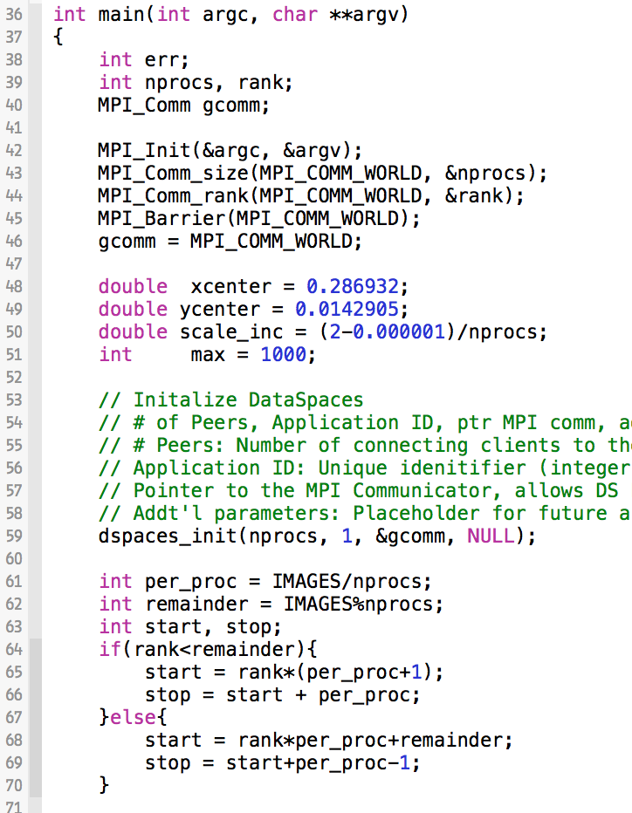
Example 6, testw.c, 2 of 4
Each of the 50 images will have the same x and y values, but adjusted scale value. We will go from 2 down to 0.000001 for the scale. We must compute the increments for the scale.
Divide the work for computing and writing the different arrays to the space

Slide 78
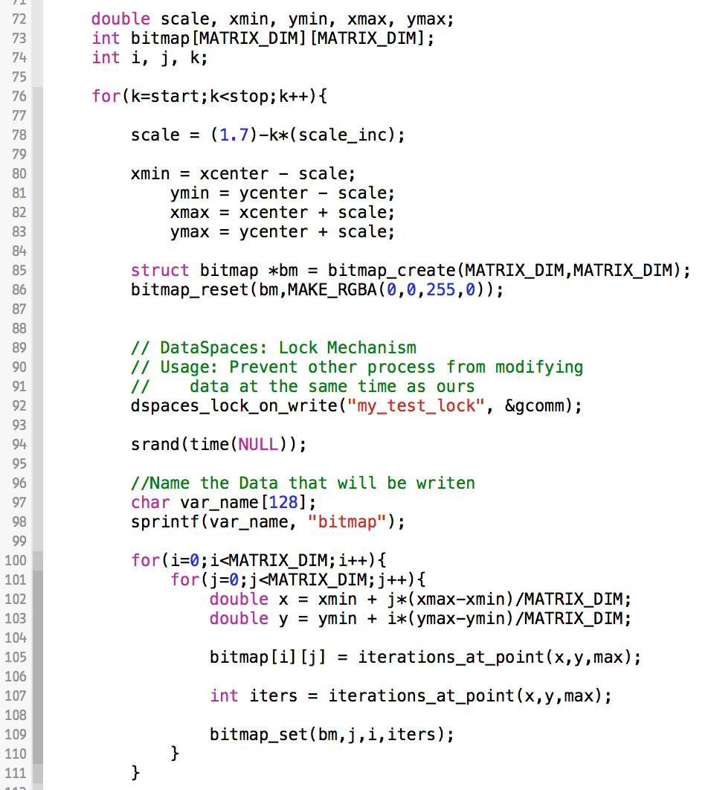
Example 6, testw.c, 3 of 4
Each iteration through this loop generates 1 image. The start and stop factors are for each process.
Compute the scale using the increment
Setup the structure to create the bitmap image
Generate the individual values for the 512x512 array

Slide 79
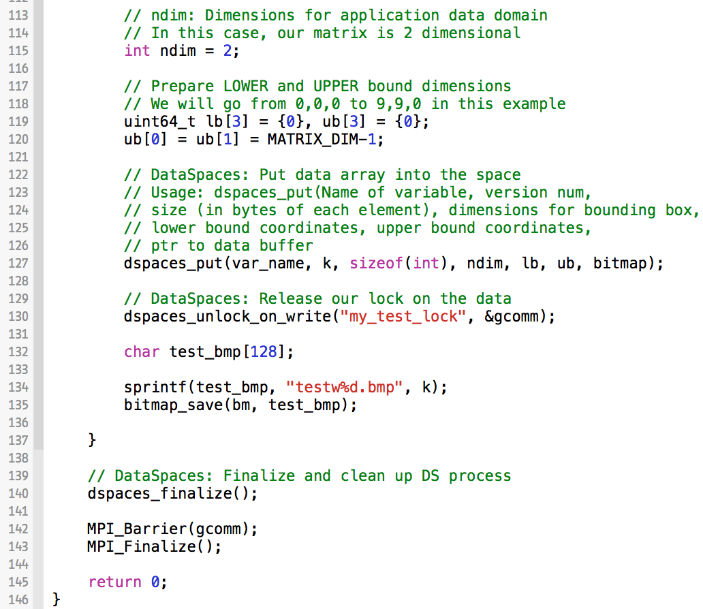
Example 6, testw.c, 4 of 4
Put the entire 512x512 array into the space by setting the bound to 0,0,0-512,512,0 and then calling dspaces_put
Note that we adjust the version number to be the k^{th} iteration number
Write the black and white test bitmap image to our working directory (disk) for verification purposes

Slide 80
Example 6, Get Tasks from the Space According to Rank, Operate on this Data
0
get()
1
get()
512x512
DataSpaces
Staging Area
2
get()
512x512
512x512
get()
…
47
get()
48
get()
512x512
49
512x512
512x512

Slide 81
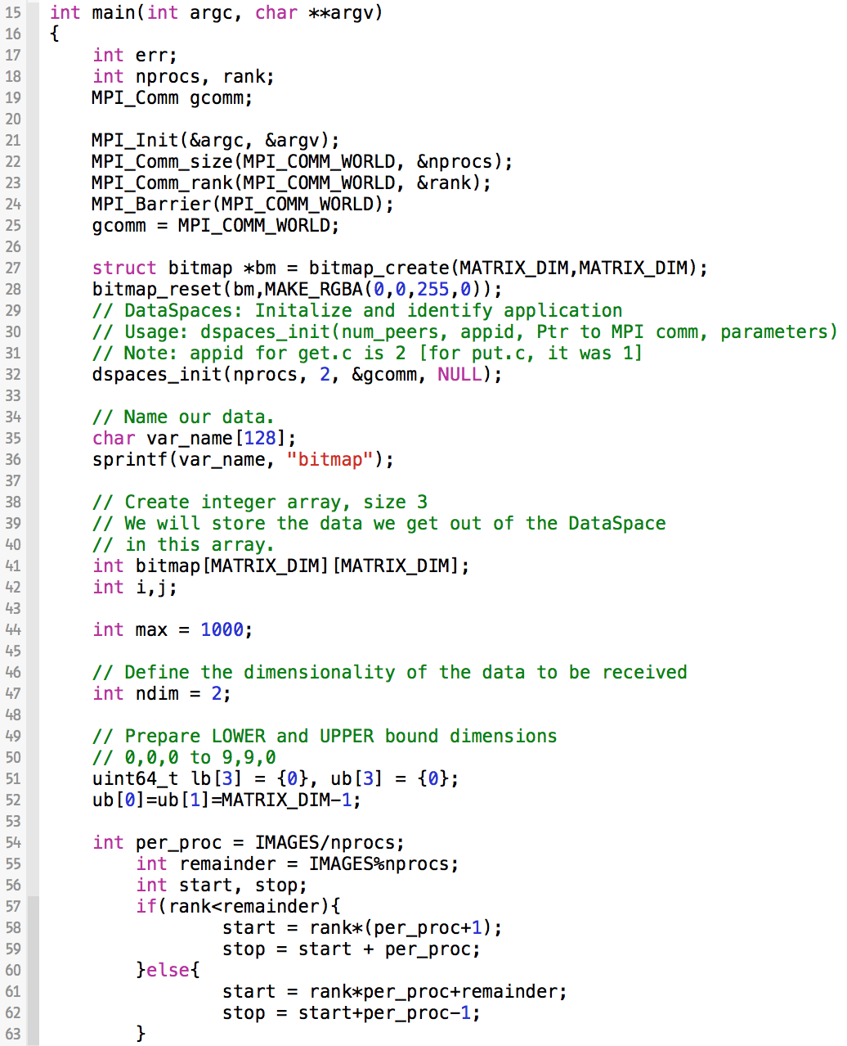
Example 6, testr.c, 1 of 2
Setup the structure to create the bitmap image
Setup the buffer for the 512x512 matrix
Divide the work for the 50 images among the number of processes

Slide 82
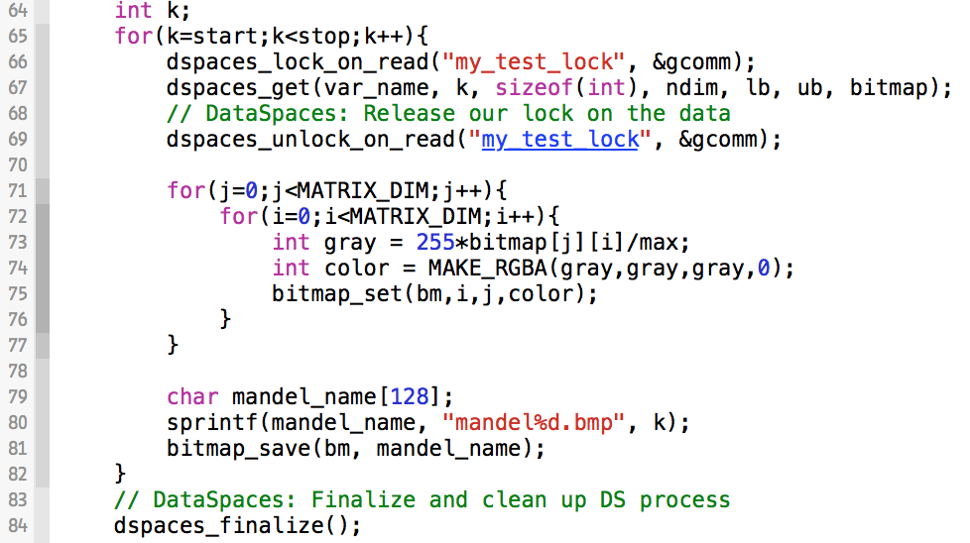
Example 6, testr.c, 2 of 2
For each iteration, get one of the 512x512 image arrays. Each value in the array represents a single pixel
Colorize each pixel based on the number of iterations it took to arrive with the value from the recurrence relation
Save the final colorized image to disk

Slide 83
Example 6: Running the Mandelbrot Example
We are creating 50 IMAGES in this example. The height/width are adjustable via MATRIX_DIM compile option and images can vary using IMAGES compile option (see .c files).
Open the job script. In this case, we are passing some command line information to the master.
$ vim job.sh
./master -x 0.286932 -y 0.014287 -s .0005 -m 1000
ibrun -o 2 -n 5 ./worker

Slide 84
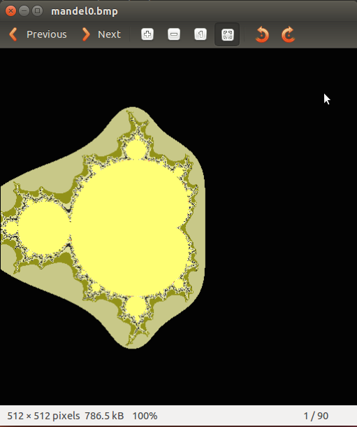
Example 6: Examining the Output
Unfortunately, we will not view this data on Stampede. We can scp an image or two back to our local machine if we want to see our data.
You could also compile the pictures into a movie, where the scale is steadily decreasing, resolution increasing.

Slide 85
Example 6: scp
On your local machine:
$ scp train##@stampede.tacc.utexas.edu:~/examples/mandelbrot/mandel*.bmp .
where train## is your account number, e.g. train55. Enter your password.
This copies all 50 files into whatever directory you are currently in on your home machine. To select certain files, change the asterisk to a number.
I recommend the two end points: mandel0.bmp and mandel49.bmp.

Slide 86
Congratulations!
You have completed the
DataSpaces Tutorial.
What next?

Slide 87
More Complex Examples
In the source code directory, there are test_put_run.c and test_get_run.c applications that show some more advanced usage modes for DS. Also, test_reader.c and test_writer.c.
$ dataspaces-1.5.0/tests/C
For help with your specific code, please use our mailing list! We are open to collaborations in all types of fields!

Slide 88
Thank You!!!
Questions?
For more information, please visit
http://www.dataspaces.org
Mailing List: dataspaces@cac.rutgers.edu

Slide 89
Some FAQs
Does the data domain require integer coordinates to access (i.e., in our examples: uint_64t)?
In the current implementation, yes.
Does application domain have to be n-d rectangular?
Yes, some translation from original domain to n-d domain. For example, if you have an irregular shape/surface, there has to be some mapping or translation to an n-d domain (could be as simple as enclosing the area in the largest box that can fit it).
Can I have multiple, completely separate staging areas consisting of multiple instances of DataSpaces servers?
In practice, yes, but this usage mode is rarely used.

